Slide 1
Understanding and Working With Parents Who Have a History of Complex Trauma
Hot Topic
June 18th
Espen Klausen, Ph.D.
Licensed Psychologist with
Fond du Lac County’s
Department of Community Programs

Slide 2
All pictures are courtesy of christinaklausenphotography.com

Slide 3
Overview
Physiological effects on the brain
Learned emotional reactions
Learned reaction to own emotions
How to work around these

Slide 4
Awareness and Mindfulness
Above all:
BE MINDFUL OF THEIR TRAUMA
AND ITS EFFECTS
Resist focusing on
“irresponsibility” or personality
Focus on skills and ways to get
around challenges
Do not re-traumatize

Slide 5
Discussing the Trauma May Destabilize the Parent
Do not request detailed disclosure
Revisiting the trauma destabilizes
It should be discouraged unless
The person is already used to talking about it
The person is very stable (in the moment and in general)
Even a trauma therapist will not ask about details or disclosure of the trauma before significant stability has been achieved

Slide 6
Prolonged Cortisol Flooding
Mid-brain shrinks
More erratic emotions
Compromised memory
switchboard

Slide 7
Memory
Learned memories and prospective memory will be discussed later
Memory switchboard in the mid-brain may be compromised
What memory is triggered may be unpredictable
Mind may understand things in other ways
May misunderstand things
May answer questions in unusual directions

Slide 8
How to Work Around Memory Challenges
Summarize major points and take-home messages verbally AND in written summaries –
have them reread and initial it soon afterwards
memories can get distorted
Stay very focused on what they need to remember
Number the items (“for next time, do 1)… 2)… and 3)…”)
Prompt them to make examples
Attach new procedures or tasks to existing routines
Provide visual guides and reminders that are not just written

Slide 9
Tuning of anxiety system
Tuned through experience
Fire alarm analogy
Louder
Quicker
Anxiety – anger

Slide 10
How work around the tuned anxiety and erratic emotional system
Never use absolutes unless absolutely necessary
Use ratings (e.g., 0-10 scale) to prevent black and white thinking
“You gave that message to your son at a ‘6.’ Nice
job. If you maintain eye-contact
a little more, your assertiveness
will be at a ‘7’”

Slide 11
How work around the tuned anxiety and erratic emotional system
Validate and respect that the person has the emotional reaction before moving on to rational thinking
You: “How bad – 0-10 - do you feel when your son cries when in time-out?”
Him: “A ‘9’.”
You: “How big of a deal is it that he cries while in time out?”
Him: “A ‘7’”
You: “Last week you said that it was a ‘7’” when he ran out of the house and did not come back for 3 hours – is his crying in time-out a bigger or smaller deal than that?”
Him: “Oh – that was way worse. I guess his crying is more like a ‘4’”
Use specifics and numbers (speaks to the rational left hemisphere) rather than vague terms (speak to the more emotional right hemisphere)
Do: “2 times each day” – Not: “a couple times a day”
Do: “Next week Thursday” – Not: “toward the end of next week”
Do: “You have two more goals to complete” – Not: “You still have a ways to go on your goals”

Slide 12
Classical Conditioning
Repeated pairing of a stimuli and an emotion
That stimuli can create that emotion on its own and in other contexts
The emotional reaction is involuntary
Must not be blamed
Should be seen as natural given their experiences
Keep a log of such triggering stimuli
Avoid such stimuli (unless absolutely necessary for the work)
Be mindful of triggering stimuli that may be involved in parenting situations
Often unaware of the connection
May find other things to which to attribute the emotion
Help them create positive experiences with parenting so that parenting creates more positive feelings in the future
Too much confrontation about their parenting will make parenting something that evokes negative emotions

Slide 13
Senses
Be mindful of all the senses in identifying triggers
We tend to focus on:
Hearing
Seeing
We should also tune more into:
Smell (most potent sense in its effects on emotions and memory)
Touch (often potent if a history of sexual abuse)
Taste
There are other senses to keep in mind as well:
Vestibular (direction of the head relative to the direction of gravity)
Kinesthetic
Temperature
Pressure
Viscosity

Slide 14
Frontal Lobe/Executive Functioning
Likely to be underdeveloped if:
Unpredictability and chaos
Family or child’s mind frequently in survival mode
More likely to develop well and become strong if growing up with:
Structure
Clear connections between cause and effect (e.g., behaviors and consequences)
Problems with these in the home tend to be cross-generational

Slide 15
Frontal Lobe/Executive Functioning
Also Impaired by:
Alcohol and recreational drug use
Ongoing-stress
Multi-tasking
Poor sleep
Hunger
Any physical problem causing fogginess (e.g., some allergies)
Dissociation (discussed later)

Slide 16
Frontal Lobe/Executive Functioning
Responsible for:
Our consciousness
Planning
Filtering what we should not pay attention to
Over-riding impulses from the rest of the brain
Motivation to push through resistance (e.g., self-activation when mind or body wants to be inactive)
Bring up information at the right time in the future (prospective memory)
Holding several bits of information in your consciousness simultaneously (working memory)
When tasks are too much for frontal lobe to handle we become over-whelmed
When over-loaded we make impulsive choices

Slide 17
Executive functioning – prospective memory
Proactive memory a matter of both memory (mid-brain) and frontal lobe
Use calendars, appointment books, electronic devises with reminders
Don’t confuse poor prospective memory with lack of investment
Don’t confuse poor organization skills with lack of investment
Challenge them on not applying skills and reminder tools – not on lack of caring or poor priorities
Prompt them to make images in their head of where they are when they need to remember it and a clue as to what – the wilder the image the better
“I picture my daughter in her time-out spot. She looks and sounds like a banshee. I see the mime me standing there as well – this silent, expression-less mime”

Slide 18
Planning
Help them get a way from planning to do something at a vague time in the future
Even if can be done any-time, help them pick specific times
Coach them in setting up reminders for themselves
Practice setting down point-by-point action-tasks and goals

Slide 19
Working Memory
Most adults can hold 7 (5-9) small bits of information in their consciousness
When overloaded leads to frustration and potentially anger
When filled with something, will make impulsive choices about other things
Some available memory space is needed to store memories – multi-tasking interferes with memory creation

Slide 20
Maximizing Working Memory
Minimize multi-tasking
Ensure good sleep and eating habits
Eliminate distractions
Use pen and paper to extend the working memory
Teach them one thing at a time
May be too much to be given instructions while parenting
May benefit from review of a recording of them parenting instead

Slide 21
Filtering and focusing
Keep an agenda
Keep a visual focal point as a reminder of the focus of the discussion
Help the parent to use visual reminders of what they are focusing on in any given situation
Removal of recurring distractions (e.g., cell phones)

Slide 22
Self-activation
We have two primary modes – rest and activity
Affects both physical activation and mental set
Takes 10-15 minutes to make the switch
Don’t: “I’ll just sit down for 10 minute”
Plan the parenting and household needs accordingly
Activation jar

Slide 23
Structured Life
Good eating schedule and sleep schedule
Because of the children’s need – this is a parenting issue
A good child-friendly sleep/wake and eating schedule is a parenting skill – a good schedule is not suddenly done – it is something the brain gets accustomed to
Improves growth and functioning of the frontal lobe
Improves long-term and prospective memory
Reduces emotional reactivity

Slide 24
Dysthymia
If memories and emotions have been
Frequently and intensely unpleasant
Dismissed or given a bas reception if expressed
Dysthymic state of signals from the mid-brain being filtered out and not reaching the awareness centers
Functioning (but not thriving)
Memories are vague
Few difficult emotions
Almost no enjoyment of anything
Flattened affect (interferes with bonding and more)
Poor motivation
May have explosive anger

Slide 25
Dysthymia
Refer to psycho-
Therapy.
They are often not
aware that their mild
depressive state is not
normal

Slide 26
Circumventing Dysthymia -Vague Memories-
If they have a hard time accessing details of memories, loosen up their mind by asking about specific sensory experiences
“When you were watching the children at the park on Friday, what was the weather like? The temperature? What color was the play equipment? What noises could you hear?”

Slide 27
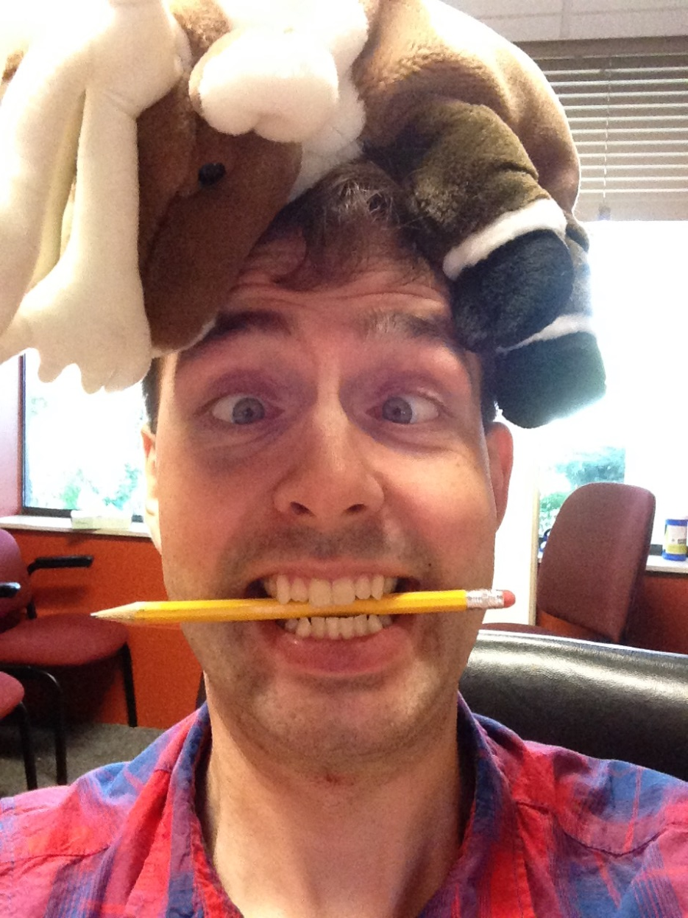
Circumventing Flattened Affect
Flattened affect is a
parenting issue
Weak muscles
Bite a pencil for 20 min
Do not let the lips
touch the pencil
2+ times/day

Slide 28
Dissociation
A coping strategy children often naturally use during trauma
Mental disconnection from their own body and environment
If having learned to do it during trauma may start doing it in other anxiety provoking situations
Is often misdiagnosed as Attention-Deficit/Hyperactivity Disorder, inattentive type
May continue into adulthood
Then interferes with adult life and with parenting
Interferes with parenting and adult life in general

Slide 29
Working with Dissociation
Watch out for eyes going “blank” or sudden changes in how they process information (they may seem high or dazed – or suddenly rigidly defensive)
They are unlikely to remember details of what goes on while dissociated, so step back and regroup
Keep track of what triggers dissociation
Find an agreed-upon signal by you if you catch them dissociating (with you or while parenting)
Then work with them on using a grounding tool – they often already have them – just not realizing that this is how they use it

Slide 30
Dissociation Continued
Grounding tools brings them out of the dissociation and back in contact with what they need to deal with around them
It is not the same as forms of coping that distracts them away from reality
Grounding techniques some respond to:
Deep breathing (10+% will get more anxious)
Rubbing something with a specific
texture (special coin, smooth stone,
silk border)
Putting on a heavy vest
(or leather jacket)
Tapping one or more specific spots on
their own body
Release a smell that is pleasant and that
they started using after had escaped the
trauma and during a time they felt safe
Suck on a flavor of candy
(as with the smell)
A brief body movement from Tai Chi,
yoga, or other body exercise
(as with the smell and taste)

